Slide 1
Chapter 17
Files in Python

Slide 2
List of contents
Files
Types of files in python
Opening a file
Closing a file
Working with text files containing strings
Knowing whether a file exists or not
Working with binary files
The with statement
Pickle in python
The seek() and tell() methods
Random accessing of binary files
Random accessing of binary files using mmap
Zipping and unzipping files
Working with directories
Running other programs from python program

Slide 3
Introduction
We use different files in our daily life.
For example, we may keep all our school certificates in a file and call it 'certificates file'. This file contains several certificates or pages and each page contains some data.
From this example, we can simply say that a file is a place for storing data. Similarly, when we go to an office, we can see a book that contains the attendance of the employees. This book is called `attendance file' since it contains attendance data of employees.
Let's understand that if the data is stored in a place, it is called a file.

Slide 4
Files
Data is very important. Every organization depends on its data for continuing its business operations. If the data is lost, the organization has to be closed. This is the reason computers are primarily created for handling data, especially for storing and retrieving data. In later days, programs are developed to process the data that is stored in the computer.
To store data in a computer, we need files. For example, we can store employee data like employee number, name and salary in a file in the computer and later use it whenever we want. Similarly, we can store student data like student roll number, name and marks in the computer. In computers' view, a file is nothing but collection of data that is available to a program. Once we store data in a computer file, we can retrieve it and use it depending on our requirements. Following Figure shows the file in our daily life and the file stored in the computer:

Slide 5
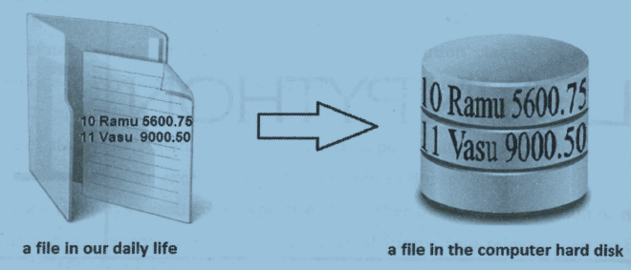

Slide 6
There are four important advantages of storing data in a file:
When the data is stored in a file, it is stored permanently. This means that even though the computer is switched off, the data is not removed from the memory since the file is stored on hard disk or CD. This file data can be utilized later, whenever required.
It is possible to update the file data. For example, we can add new data to the existing file, delete unnecessary data from the file and modify the available data of the file. This makes the file more useful
Once the data is stored in a file, the same data can be shared by various programs. For example, once employee data is stored in a file, it can be used in a program to calculate employees' net salaries or in another program to calculate income tax payable by the employees.
Files are highly useful to store huge amount of data. For example, voters' list or census data.

Slide 7
Types of files in python
In Python, there are two types of files. They are:
Text files
Binary files
Text files store the data in the form of characters. For example, if we store employee name "Ganesh", it will be stored as 6 characters and the employee salary 8900.75 is stored as 7 characters. Normally, text files are used to store characters or strings.
Binary files store entire data in the form of bytes, i.e. a group of 8 bits each. For example, a character is stored as a byte and an integer is stored in the form of 8 bytes (on a 64 bit machine). When the data is retrieved from the binary file, the programmer can retrieve the data as bytes. Binary files can be used to store text, images, audio and video.
It is very important to know how to create files, store data in the files and retrieve the data from the files in Python. To do any operation on files, first of all we should open the files.

Slide 8
Opening a file
We should use open() function to open a file. This function accepts 'filename' and 'open mode' in which to open the file.
file handler = open ("file name", "open mode", "buffering")
Here, the 'file name' represents a name on which the data is stored. We can use any name to reflect the actual data. For example, we can use `empdata' as file name to represent the employee data.
The file 'open mode' represents the purpose of opening the file
A buffer represents a temporary block of memory. 'buffering' is an optional integer used to set the size of the buffer for the file. In the binary mode, we can pass 0 as buffering integer to inform not to use any buffering. In text mode, we can use 1 for buffering to retrieve data from the file one line at a time. Apart from these, we can use any positive integer for buffering. Suppose, we use 500, then a buffer of 500 bytes size is used via which the data is read or written. If we do not mention any buffering integer, then the default buffer size used is 4096 or 8192 bytes.

Slide 9
File open mode | Description
w | To write data into file. If any data is already present in the file, it would be deleted and the present data will be stored.
r | To read data from the file. The file pointer is positioned at the beginning of the file.
a | To append data to the file. Appending means adding at the end of existing data. The file pointer is placed at the end of the file. If the file does not exist, it will create a new file for writing data.
w+ | To write and read data of a file. The previous data in the file will be deleted.
r+ | To read and write data into a file. The previous data in the file will not be deleted. The file pointer is placed at the beginning of the file.
a+ | To append and read data of a file. The file pointer will be at the end of the file if the file exists. If the file does not exist, it creates a new file for reading and writing.
x | To open the file in exclusive creation mode. The file creation fails if the file already exists.

Slide 10
closing a file
When the open() function is used to open a file, it returns a pointer to the beginning of the file. This is called 'file handler' or 'file object'. As an example, to open a file for storing data into it, we can written the open() function as:
f = open("myfile.txt", "w")
Here, 'f' represents the file handler or file object. It refers to the file with the name "myfile.txt" that is opened in "w" mode. This means, we can write data into the file but we cannot read data from this file. If this file exists already, then its contents are deleted and the present data is stored into the file.
A file which is opened should be closed using the close() method. Once a file is opened but not closed, then the data of the file may be corrupted or deleted in some cases. Also, if the file is not closed, the memory utilized by the file is not freed, leading to problems like insufficient memory. This happens when we are working with several files simultaneously. Hence it is mandatory to close the file.
f.close()
Go to Jupyter notebook for examples

Slide 11
Working with text files containing strings
To store a group of strings into a text file, we have to use the write() method inside a loop.
f.read() method reads all the lines of the text file and displays them line by line as they were stored in the text file. This method reads all the lines of the text file and displays them line by line as they were stored in the “textfile1.txt". Consider the following output:
This is line one. This is line two.
There is another method by the name readlines() that reads all the lines into a list. This can be used as:
f. readlines()
This method displays all the strings as elements in a list. The " \ n" character is visible at the end of each string, as:
['This is line one.\n', 'This is line two.\n']
If we want to suppress the "\n" characters, then we can use read() method with splitlines() method as:
f. read(). spltlines()
In this case the output will be: [‘This is line one.’, ‘This is line two.’]
Go to Jupyter notebook for examples

Slide 12
We will plan another program to append data to the existing "myfile.txt" and then to display the data. For this purpose, we should open the file in 'append and read' mode as:
f = open(‘textfile1.txt', 'a+')
Once the file is opened in `a+' mode, as usual we can use write() method to append the strings to the file. After writing the data, without closing the file, we can read strings from the file. But first of all, we should place the file handler to the beginning of the file using seek() method.
f.seek(offset, whence)
Here, ‘offset’ represents how many bytes to move.
The ‘whence’ represents from which position to move.
By default ‘whence’ is 0 represents from beginning of file, 1 represents from the current position in the file and 2 represents from the ending of file.
f.seek(10, 0)
This will position the file handler at 10th byte from the beginning of the file. So, any reading operation will read data from 10th byte onwards.
f.seek(0, 0)
This will position the file handler at the 0th byte from the beginning of the file. It means any reading operation will read the data quite from the beginning of the file.
Go to Jupyter notebook for example

Slide 13
Knowing whether a file exists or not
The operating system (os) module has a sub module by the name 'path' that contains a method isfile(). This method can be used to know whether a file that we are opening really exists or not.
For example, os.path.isfile(fname) gives True if the file exists, otherwise False.
Go to Jupyter notebook for example

Slide 14
Working with binary files
Binary files handle data in the form of bytes. Hence, they can be used to read or write text, images or audio and video files.
To open a binary file for reading purpose, we can use 'rb' mode. Here, 'b' is attached to 'r' to represent that it is a binary file.
Similarly to write bytes into a binary file, we can use `wb' mode.
To read bytes from a binary file, we can use the read() method and to write bytes into a binary file, we can use the write() methods.
Let's write a program where we want to open an image file like .jpg, .gif or .png file and read bytes from that file. These bytes are then written into a new binary file. It means we are copying an image file as another file.
Go to Jupyter notebook for example

Slide 15
The with statement
The 'with' statement can be used while opening a file. The advantage of with statement is that it will take care of closing a file which is opened by it. Hence, we need not close the file explicitly. In case of an exception also, 'with' statement will close the file before the exception is handled.
The format of using 'with' is:
with open("filename", "openmode") as fileobject:
Go to Jupyter notebook for example

Slide 16
Pickle in python
So far, we wrote some programs where we stored only text into the files and retrieved same text from the files. These text files are useful when we do not want to perform any calculations on the data.
What happens if we want to store some structured data in the files?
For example, we want to store some employee details like employee identification number (int type), name (string type) and salary (float type) in a file. This data is well structured and got different types. To store such data, we need to create a class Employee with the instance variables id, name and sal
Then we create an object to this class and store actual data into that object. Later, this object should be stored into a binary file in the form of bytes. This is called pickle or serialization. So, let's understand that pickle is a process of converting a class object into a byte stream so that it can be stored into a file. This is also called object serialization.

Slide 17
Pickling is done using the dump() method of `pickle' module as:
pickle.dump(object, file)
The preceding statement stores the 'object' into the binary 'file'. Once the objects are stored into a file, we can read them from the file at any time. Unpickle is a process whereby a byte stream is converted back into a class object. It means, unpickling represents reading the class objects from the file. Unpickling is also called de­searialization. Unpickling is done using the load() method of 'pickle' module as:
object = pickle.load(file)
Here, the load() method reads an object from a binary 'file' and returns it into 'object'. Let's remember that pickling and unpickling should be done using binary files since they support byte streams. The word stream represents data flow. So, byte stream represents flow of bytes.
Go to IDLE for example

Slide 18
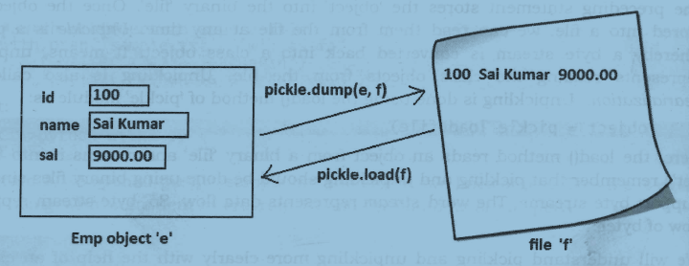

Slide 19
The seek() and tell() methods
We know that data in the binary files is stored in the form of bytes. When we conduct reading or writing operations on a binary file, a file pointer moves inside the file depending on how many bytes are written or read from the file.
For example, if we read 10 bytes of data from a file, the file pointer will be positioned at the 10th byte so that it is possible to continue reading from the 11th byte onwards. To know the position of the file pointer, we can use the tell() method. It returns the current position of the file pointer from the beginning of the file. It is used in the form:
n = f.tell()
Here, ‘f’ represents file handler or file object. 'n' is an integer that represents the byte position where the file pointer is positioned.

Slide 20
In case, we want to move the file pointer to another position, we can use the seek() method.
f.seek(offset, fromwhere)
Here, 'offset' represents how many bytes to move. 'fromwhere' represents from which position to move. For example, `fromwhere' can be 0, 1 or 2. Here, 0 represents from the beginning of the file, 1 represents from the current position and 2 represents from the ending of the file. The default value of 'fromwhere' is 0, i.e. beginning of the file.
f.seek(10) # same as f.seek(10, 0)
This will move the file pointer to the 11th byte (i.e. 10+ 1) from the beginning of the file (0 represents beginning of the file). So, any reading operation will read data from 11th byte onwords
f.seek(-10, 2)
This will move the file pointer to the 9th byte (-10+1) from the ending of the file (2 represents ending of the file). The negative sign before 10 represents moving back in the file

Slide 21
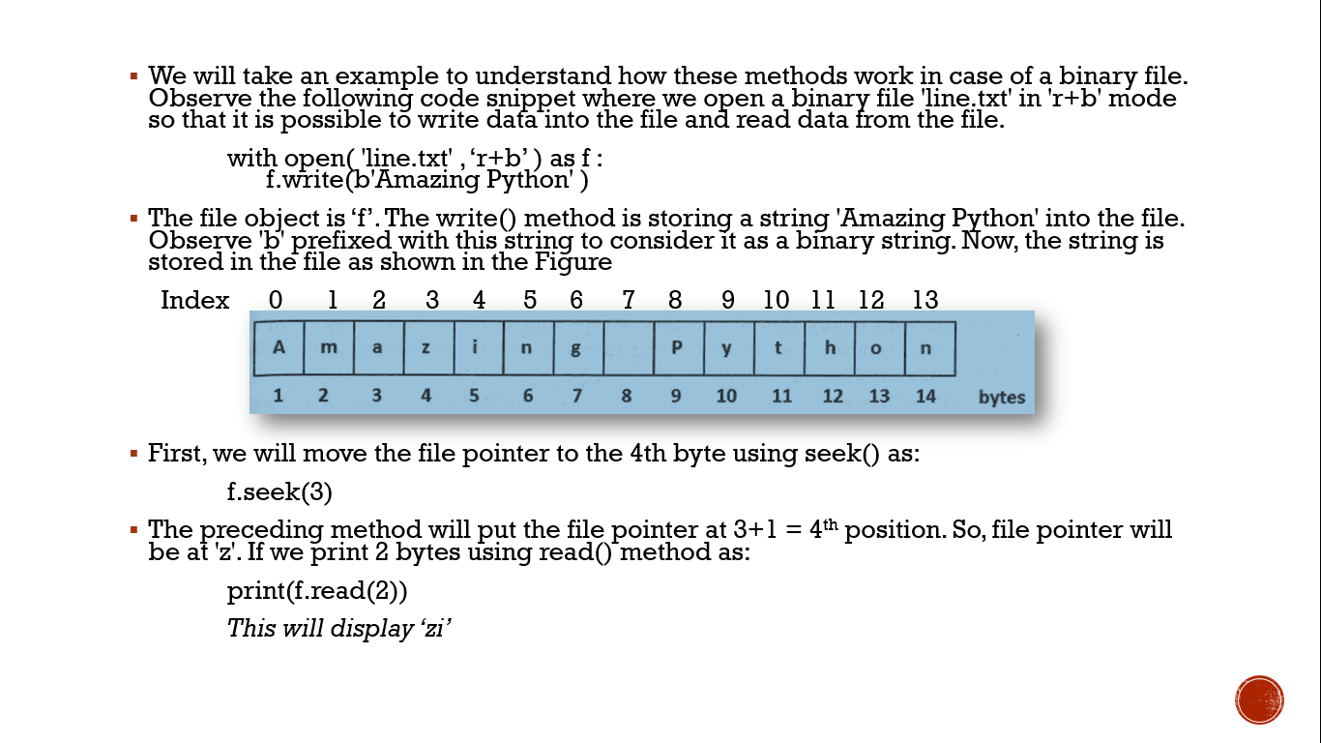

Slide 22
Now, to know the position of the file pointer we can use tell() method
print(f.tell())
This will display 5.
Now, to move the file pointer to 5th position from the ending of the file, we can use seek() method as:
f.seek(-6, 2)
This will move the file pointer to -6+1 = 5th position. It means it will be positioned at the character 'y'. We can display this character using read() method as:
print(f. read(1))
This will display 'y'.
Now, we can find the position of the file pointer using the tell() method as:
print(f.tell())
This will display 10 as the character 'y' is at 10th position from the beginning of the file.

Slide 23
Random accessing of binary files
Data in the binary files is stored in the form of continuous bytes. Let's take a binary file having 1000 bytes of data. If we want to access the last 10 bytes of data, it is not needed to search the file byte by byte from the beginning. It is possible to directly go to 991st byte using the seek() method as:
f . seek (990)
Then read the last 10 bytes using the read() method as:
f.read(10)
In this way, directly going to any byte in the binary file is called random accessing

Slide 24
A problem with binary files is that they accept data in the form of bytes or in binary format. For example, if we store a string into a binary file, as shown in the following statement, we will end up with an error.
str = 'Dear'
with open('data.bin', 'wb') as f:
f.write(str) # store str
f.write('Hello') # store 'Hello'
The preceding code will display the following error:
TypeError: ‘str’ does not support the buffer interface.
The reason behind this error is that we are trying to store strings into a binary file without converting them into binary format. So, the solution is to convert the ordinary strings into binary format before they are stored into the binary file.

Slide 25
Now consider the following code:
str = 'Dear'
with open('data.bin', 'wb') as f:
f.write(str . encode ())
f.write(b'Hello')
Converting a string literal into binary format can be done by prefixing the character ‘b’ before the string, as: b'Hello'. On the other hand, to convert a string variable into binary format, we have to use encode() method, as: str.encode().
The encode() method represents the string in byte format so that it can be stored into the binary file. Similarly, when we read a string from a binary file, it is advisable to convert it into ordinary text format using decode() method, as: str.decode().
Go to Jupyter notebook for example

Slide 26
Random accessing of binary files using mmap
mmap - 'memory mapped file' is a module in Python that is useful to map or link to a binary file and manipulate the data of the file as we do with the strings. It means, once a binary file is created with some data, that data is viewed as strings and can be manipulated using mmap module. The first step to use the mmap module is to map the file using the mmap() method as:
mm = mmap . mmap( f . fileno() , 0 )
This will map the currently opened file (i.e. ‘f’) with the file object 'mm'. Please observe the arguments of mmap() method. The first argument is ‘f.fileno()’. This indicates that fileno() is a handle to the file object ‘f’. This 'f' represents the actual binary file that is being mapped. The second argument is zero ( 0 ) represents the total size of the file should be considered for mapping. So, the entire file represented by the file object ‘f’ is mapped in memory to the object 'mm'. This means, `mm' will now onwards behave like the file ‘f’.

Slide 27
Now, we can read the data from the file using read() or readline() methods as:
print(mm.read()) # displays entire file data
print(mm.readline()) # displays the first line of the file
Also, we can retrieve data from the file using slicing operator as:
print(mm[5:]) # display from 5th byte till the end
print(mm[5:10]) # display from 5th to 9th bytes
It is also possible to modify or replace the data of the file using slicing as:
mm[5:10] = str # replace from 5th to 9th characters by string 'str'
We can also use find() method that returns the first position of a string in the file as:
n = mm.find(name) # return the position of name in the file
We can also use seek() method to position the file pointer to any position we want as:
mm.seek(10, 0) # position the file pointer to 10th byte from beginning of file

Slide 28
Let's remember that the memory mapping is done only for the binary files and not for the text files. So, first of all let's create a binary file where we want to store some strings. Suppose we want to store name and phone number into the file, we can use write() method as:
f.write(name+phone)
This will store name and phone number as one concatenated string into the file object T. But we are supposed to convert these strings into binary (bytes) format before they are stored into the file. For this purpose, we should use encode() method as:
name = name.encode() # convert name from string to binary string
The encode() method converts the strings into bytes so that they can be written into the file. Similarly, while reading the data from the file, we get only binary strings from the file. This binary string can be converted into ordinary string using decode() method as:
ph = ph.decode() # convert bytes into a string
Go to Jupyter notebook for example

Slide 29
Zipping and unzipping files
know that some softwares like 'winzip' provide zipping and unzipping of file data. In zipping the file contents, following two things could happen:
The file contents are compressed and hence the size will be reduced.
The format of data will be changed making it unreadable.
While zipping a file content, a zipping algorithm (logic) is used in such a way that the algorithm first finds out which bit pattern is most often repeated in the original file and replaces that bit pattern with a 0. Then the algorithm searches for the next bit pattern which is most often repeated in the input file. In its place, a 1 is substituted. The third repeated bit pattern will be replaced by 10, the fourth by 11, the fifth by 100, and so on. In this way, the original bit patterns are replaced by lesser number of bits. This file with lesser number of bits is called 'zipped file' or 'compressed file'.
To get back the original data from the zipped file, we can follow a reverse algorithm, which substitutes the original bit pattern wherever particular bits are found. This is shown in the following Figure

Slide 30
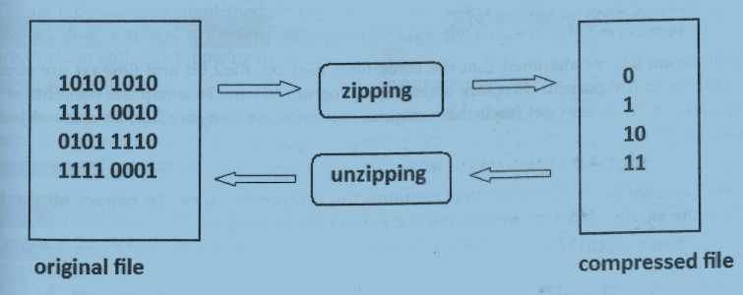

Slide 31
Python, the module zipfile contains ZipFile class that helps us to zip or unzip a file contents. For example, to zip the files, we should first pass the zip file name in write mode with an attribute ZIP_DEFLATED to the ZipFile class object as:
f = ZipFile('test.zip' 'w', ZIP_DEFLATED)
Here, 'f' is the ZipFile class object to which test.zip file name is passed. This is the zip file that is created finally. The next step is to add the filenames that are to be zipped, using write() method as:
f.write('file1.txt')
f.write('file2.txt')
Here, we are writing two files: filel.txt and file2.txt into the object ‘f’. Hence, these two files are compressed and stored into test.zip file.
Go to Jupyter notebook for example

Slide 32
Working with directories
The os (operating system) module represents operating system dependent functionality. This module is useful to perform some simple operations on directories.
Let's assume we are working with the following directory path:
F:\py\enum
And we are currently in the directory F: \py where we are running our programs. If we want to know the currently working directory, we can use getcwd() method of 'os' module as shown in the following Program.
import os
# get current working directory
current = os.getcwd()

Slide 33
If we want to create our own directory method. This method can be used as: os.mkdir('mysub' )
This will create mysub in the present directory.
Suppose, we write the statement:
os .mkdir(' mysub/mysub2 ' )
This will create mysub2 in the mysub directory.
For example, consider the following statement:
os .makedirs( ' newsub/newsub2 ')
This creates first newsub directory if it does not exist, and then it will create newsub2 inside it
We can change our current working directory to another existing directory. For this purpose, we can use chdir() method. For example, if we want to change our directory to newsub2 which is in newsub, we can use chdir() method as:
goto = os.chdir(' newsub/newsub2 ' )
Here, our assumption is that newsub is in the current directory and newsub contains newsub2. After executing, our current working directory will be newsub2.

Slide 34
To remove a directory, we can use rmdir() method of 'os' module. Let's suppose, our current directory is F: \py. In this, we have newsub directory and inside newsub, we have newsub2 directory. To remove newsub directory, we can write:
os . rmdir( 'newsub' )
The rmdir() method will remove newsub since it is found in the current directory.
Suppose, we write the following statement:
os.rmdir('newsub2')
This cannot remove newsub2 as it is not in the current directory (i.e. F: \py). newsub2 is inside newsub that is in the current directory.
In this case, path should be given properly as:
os . rmdir( 'newsub/newsub2' )
This will remove the newsub2 directory.
To give a new name to an existing directory, we can use rename() method in the following format:
os.rename('oldname', 'newname')
Here, `oldname' of the directory is changed as `newname'.

Slide 35
Sometimes, we want to know the contents of a directory. A directory may contain other directories or files. To display all the contents of a directory, we are equipped with walk() method in `os' module. This method is used in the following format:
os .walk (path, topdown=True , onerror=None , fol1owlinks=False)
This method returns an iterator object whose contents can be displayed using a for loop. This iterator object contains directory path, directory names and filenames found in a given directory path.
`path' represents the directory name. For current directory, we can use dot ( . ). Giving path is enough for walk() method.
If topdown' is True, the directory and its sub directories are traversed in top-down manner. If it is False, then the traversal will be in bottom-up manner.
`onerror' represents what to do when an error is detected. With `onerror', we can specify a function to be executed if an error is encountered.
By default, walk() will not walk down into symbolic links that resolve to directories. We should set ‘followlinks’ to True to visit directories pointed to by symbolic links, on systems that support them.
Go to Jupyter notebook for example

Slide 36
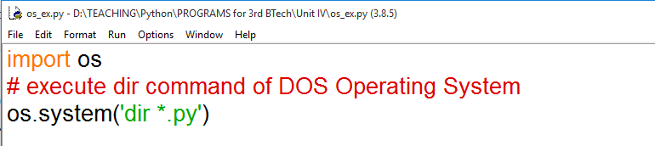
Running other programs from python program
The ‘os’ module has the system() method that is useful to run an executable program from our Python program.
This method is similar to system() function of C language. It is used as system(‘string’) where 'string' represents any command or executable file name.
Example program

Slide 37
